Slide 1

NATIONAL INSTITUTE OF TECHNOLOGY JAMSHEDPUR
COPY-MOVE FORGERY DETECTION
Team Members : Guided by :
Gourab Dutta (2020UGCS016) Dr. Jitesh Pradhan
Amisha Bairagi (2020UGCS005) CSE Department
Sahil Kumar (2020UGCS097) NIT Jamshedpur

Slide 2
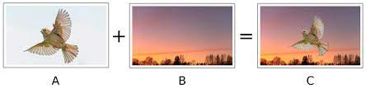
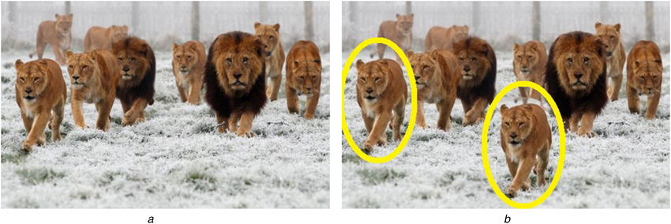
Introduction To Image Forgery
Primarily there are two kinds of forgery techniques, namely Image Splicing, and Copy-move.
In Image Splicing, different images are used to formulate forged images .
In the Copy-Move forgery technique, segments of the image are copied and pasted over the same image.
This can bring additional content within the image or it can hide the authentic information exhibited by the image.
Image Splicing Fogery
Copy-Move Forgery

Slide 3
MOTIVATION
As the region of the same image is utilized to formulate the tampered image.
Tampered region possesses the characteristics same as the rest of the image.
Several images related to man-made natural scenes often contain similar appearing but authentic objects.
Detection of copy-move forgery is a challenge because it solely depends on the region similarity present in the images.
In presence of similar-looking but authentic objects within the image, it becomes a complicated problem to differentiate between the genuine and duplicated area of the image.

Slide 4
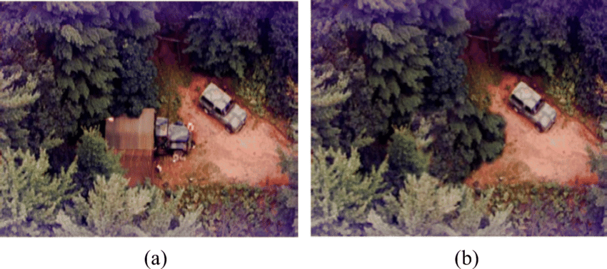
Problem Statement
To develop an algorithm or technique that can accurately identify Forged parts of the image.
The challenge is to detect copied regions despite with very slight variations .
The algorithm needs to be able to tell more than one forged region if exists.
Original Image
Forged Image

Slide 5
Literature Survey
Year | Author | Purpose
2003
Jessica Fridrich
et.al
Successfully detect the forged part even when the copied area is enhanced and when the forged image is saved in a lossy format, such as JPEG.
Babak Mahdian et.al
They proposed a method to automatically localize duplicated regions in digital images. The method is based on blur moment invariants
2006
2009
Zhang Ting, et. al
It works by first extracting singular value SV features, and is then matched to its nearest neighbors in image.
Er. Saiqa Khan et.al
The technique works by first applying Discrete Wavelet Transform (DWT) to the input image to yield a reduced dimension representation.
2010

Slide 6


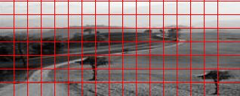
PROPOSED METHODOLOGY
Input (Host image)
Preprocessing
Preprocessed image
Overlapping block segmentation
Image Blocks
Block Feature Extraction

Slide 7
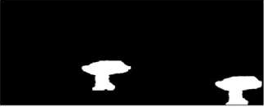
PROPOSED METHODOLOGY
Lexicographical Sorting
Feature Matching
Forged region extraction
Output:
Forged image Detected

Slide 8
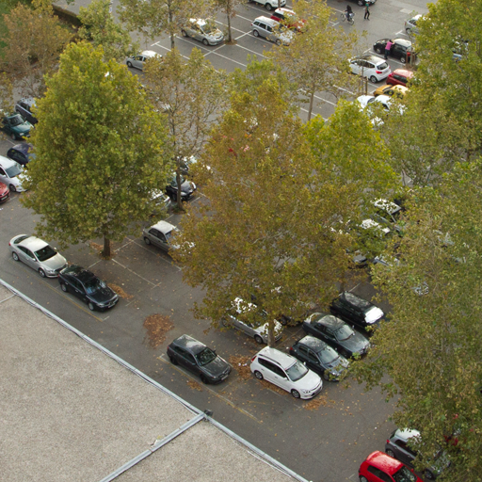
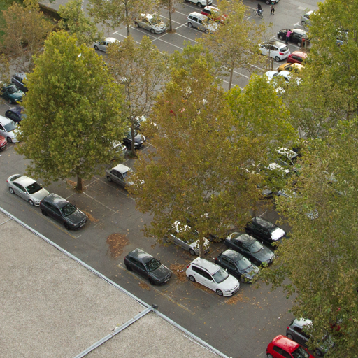


Some Experimental Outcomes
Original Image
Forged Image
Mask
Experimental result

Slide 9
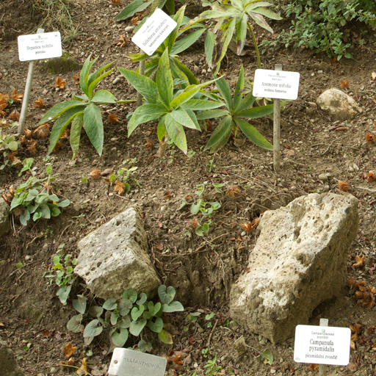
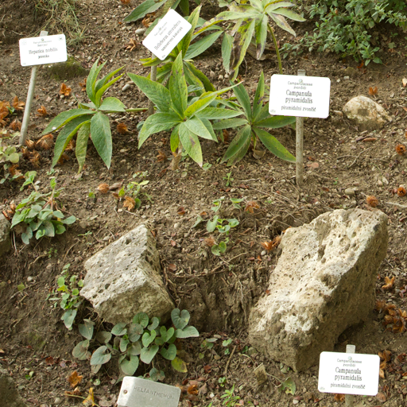
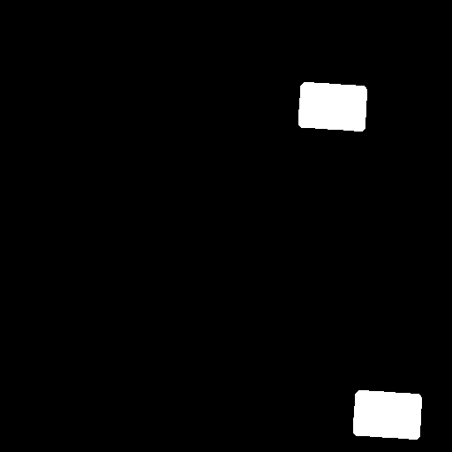
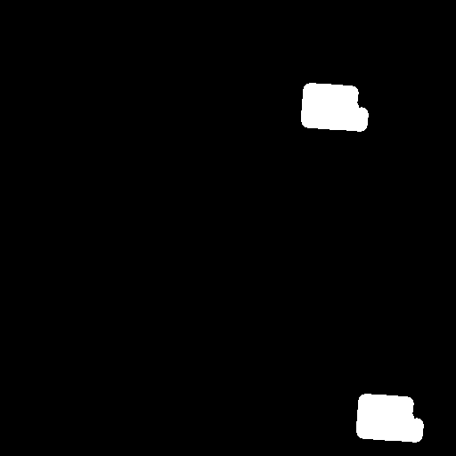
Some Experimental Outcomes
Original Image
Forged Image
Mask
Experimental result

Slide 10
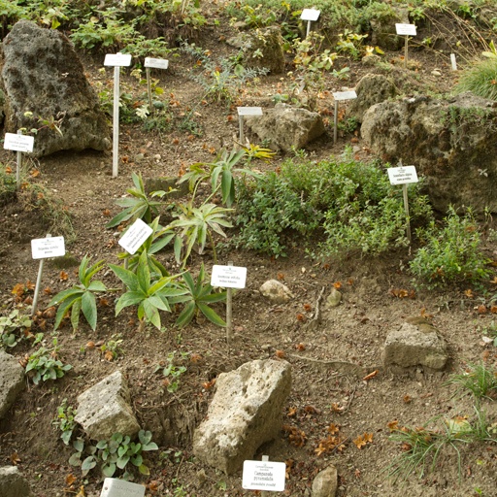
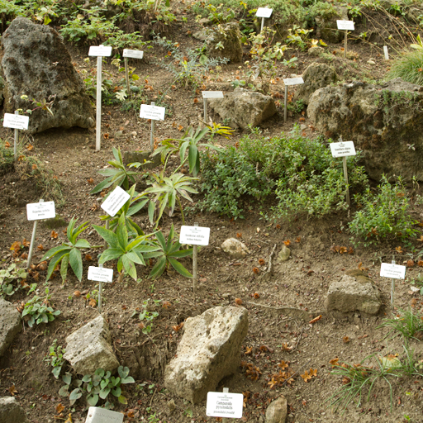
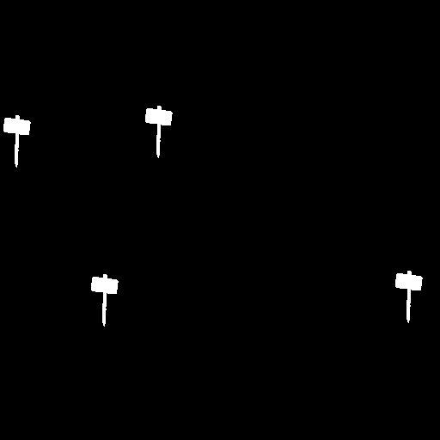

Some Experimental Outcomes
Original Image
Forged Image
Mask
Experimental result

Slide 11
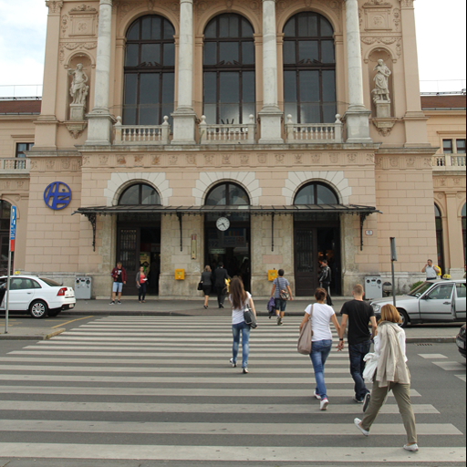
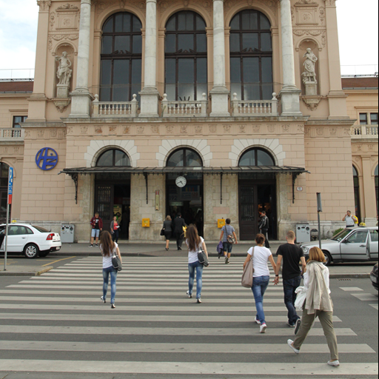
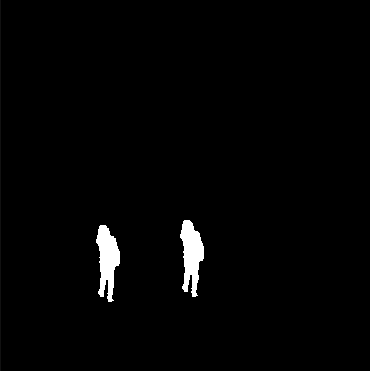

Some Experimental Outcomes
Original Image
Forged Image
Mask
Experimental result

Slide 12
Performance Metrices
S.No. | Precision | False positive rate (FPR) | Recall value | Accuracy | F-measure
1 | 1 | 0 | 0.43590952 | 0.99086761 | 0.60715458
2 | 1 | 0 | 0.9275834 | 0.99864197 | 0.96243141
3 | 1 | 0 | 0.87725999 | 0.99632263 | 0.93461747
4 | 1 | 0 | 0.59771755 | 0.90569702 | 0.74821429
Average Precision value - 1
Average False Positive Rate - 0
Average Recall value -0.70733972
Average Accuracy - 0.963705748
Average F-measure - 0.814805158

Slide 13
Future Work
Incorporating deep learning architectures
Addressing challenges in real-world applications
Deep learning-based methods for copy-move forgery detection.
This could potentially improve the accuracy and efficiency of copy-move forgery detection.
Real-world applications, such as forensics and authentication brings many new challenges.
variations in image quality, compression artifacts, and different types of forgeries.
Addressing these challenges to make method more practical and effective in real-world settings.

Slide 14
References
J. Fridrich, M. Goljan, and R. Du, "Reliable detection of copy-move forgery in digital images," IEEE Transactions on Information Forensics and Security, vol. 3, no. 3, pp. 489-499, September 2008.
Z. Yang, X. Luo, Y. Liu, and W. Sun, "A block-based approach for detecting copy-move forgery in digital images," Signal Processing, vol. 89, no. 9, pp. 1722-1731, September 2009.
X. Liu, W. Sun, and Y. Liu, "A block-based approach for detecting copy-move forgery using DCT coefficient distribution," Signal Processing, vol. 91, no. 8, pp. 1815-1824, August 2011.
M. Kim, J. Lee, and H. Lee, "A robust block-based copy-move forgery detection method using adaptive thresholding," Journal of Visual Communication and Image Representation, vol. 27, pp. 40-53, April 2015.

Slide 15
Thank You

